Slide 1
Christopher B. Barrett Cornell University James Cook University SIS group meeting July 8, 2013
Chronic Rural Poverty and Resilience:
Some Reflections and A Research Agenda

Slide 2
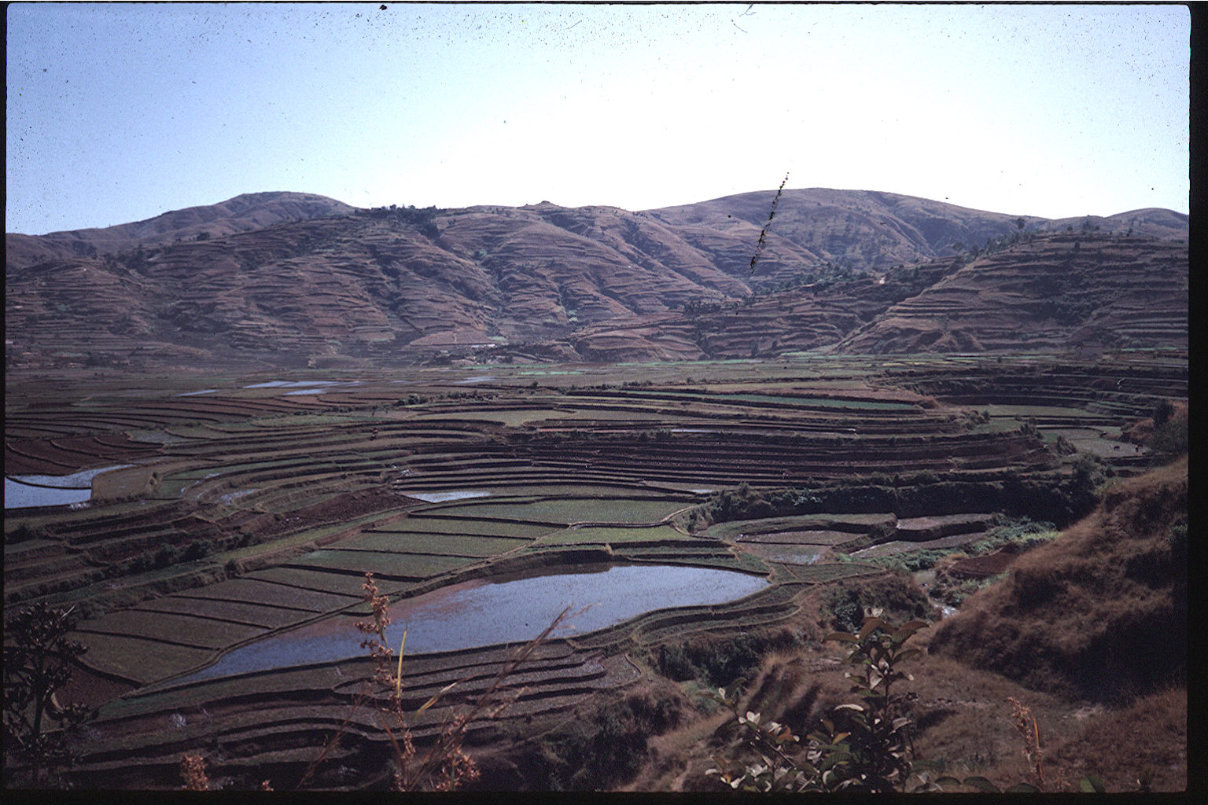
Motivation
Keen to explore how best to understand and positively influence the closely coupled dynamics of human-threatened ecosystems that are closely couple with human well-being and livelihood strategies, especially as they relate to persistent poverty and malnutrition.

Slide 3
My research group based in (development/agricultural) economics w/past and ongoing work on coupled natural and human (CNH) systems, as well as broader work on poverty dynamics, food security, productivity and markets not directly related to environmental stress. Emphasis on theoretically-grounded empirical work that can inform policymakers/practitioners.
Background

Slide 4
Background
Sample work on CNH systems (current in bold):
(1) Sustainable agricultural intensification (soil nutrients, water mgmt – Cote d’Ivoire, Ethiopia, Ghana, India, Kenya, Madagascar, Malawi, Uganda, pan-SSA)
(2) Rangelands in east Africa (Ethiopia, Kenya)
(3) Biodiversity conservation & poverty (2011 PNAS, Cameroon, Kenya, Madagascar, Tanzania, Thailand)
(4) Deforestation (Indonesia, Madagascar, Morocco)
(5) Marine protected areas (Indonesia, Philippines)
(6) Disease ecology (applied theory, Uganda)

Slide 5
Research priorities
What we understand least well:
Welfare dynamics and their relationship to ecosystem dynamics, especially with stochasticity added in …
Shocks that disrupt lives and livelihoods - the most frequent cause of descents into poverty.
Uninsured risk of catastrophic loss - discourage pursuit of high return/riskier livelihoods … a key reason for poverty traps.

Slide 6
Research priorities
Put slightly more formally, seek to learn conditional transitions:
W_{t+1}=g(W_{t}|R_{t},ε_{t})
where W is welfare, R is the state of the natural resource, and ε is an exogenous stochastic driver
And associated feedback from:
R_{t+1}=h(R_{t}|W_{t},ε_{t})
And effects of exogenous change in ε (e.g., due to climate)
means the underlying CTD changes over time.
Both human well-being and the state of natural resources are both intrinsically and instrumentally important.

Slide 7
Research priorities
One specific case: current dev’t /humanitarian communities’ fascination with “resilience”
But we lack a theory-measurement-and-evidence-based understanding of what resilience is with respect to poverty and hunger, how to measure it, and how to effectively promote it so as to reduce chronic poverty and hunger.
Working with CARE, FAO, ILRI and others on improving conceptualization/measurement
A big opportunity for ecologist – economist collaboration!

Slide 8
Four-pronged research strategy
Four-pronged strategy
Theory – Build on past work on ecological resilience and poverty traps and its relation to risk.
Measurement – This is the hardest area. What are the right dimensions/methods for measurement? Combine probabilistic quantitative measures and subjective indicators.
Impact evaluation – Once metrics established, then use longitudinal observational and experimental data to evaluate alternative interventions aimed at enhancing resilience of indivs, hhs, communities (and supporting ecosystems).
Outreach –Translate findings into clear, actionable guidance to donors, firms, gov’ts and NGOs.

Slide 9
Ways Forward
Lots of potential for collaboration around any of several topics, especially related to CNH systems, poverty traps and resilience.
Much to do in all of these areas … a massive research, teaching and outreach agenda.
Our group’s work is almost entirely in terrestrial systems, however. Very little experience in marine systems.
So look forward to further learning from JCU/CoE for CRS

Slide 10
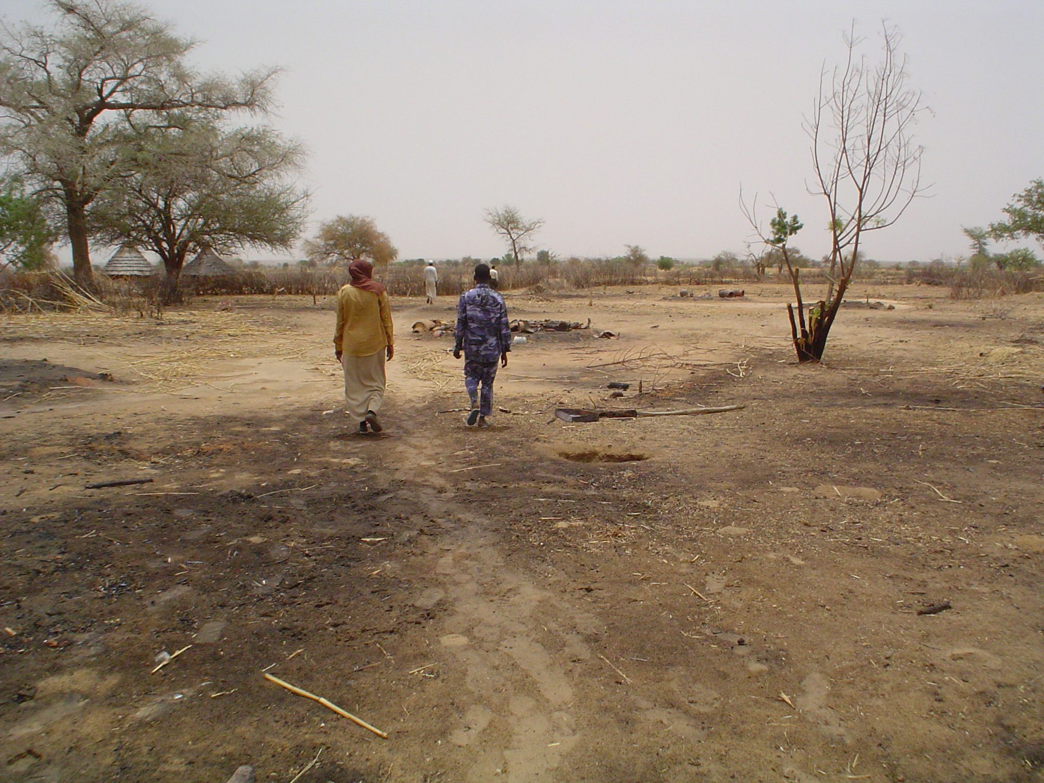
Thank you
Thank you for your time, interest and comments!

